Slide 1
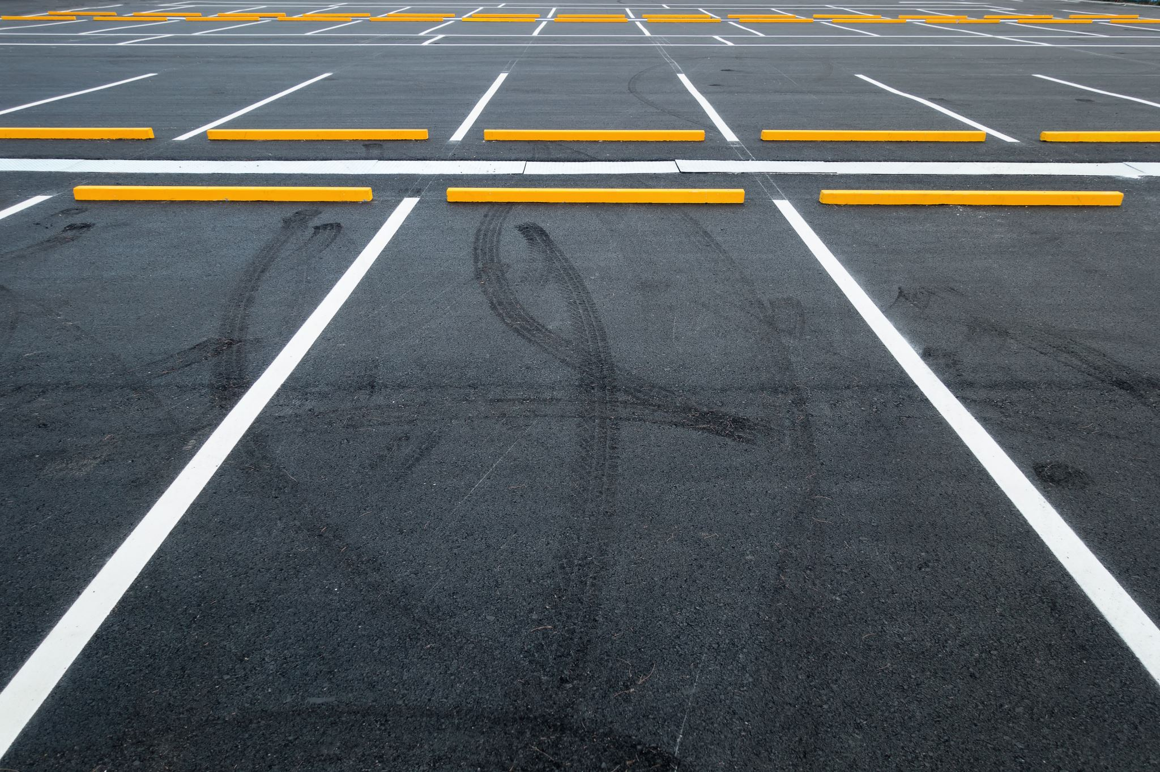
Parking Availability System
Design Prototype Milestone
The ParKings | Erik Meurrens Benjamin Simonson Ryan Jalloul Evan Tobon Samer Khatib
CEN3907C – Computer Engineering Design 1
Notes:
Something like:
“Hey everyone, my name is [NAME], we are the ParKings, and this is our project, the Parking Availability System.”

Slide 2
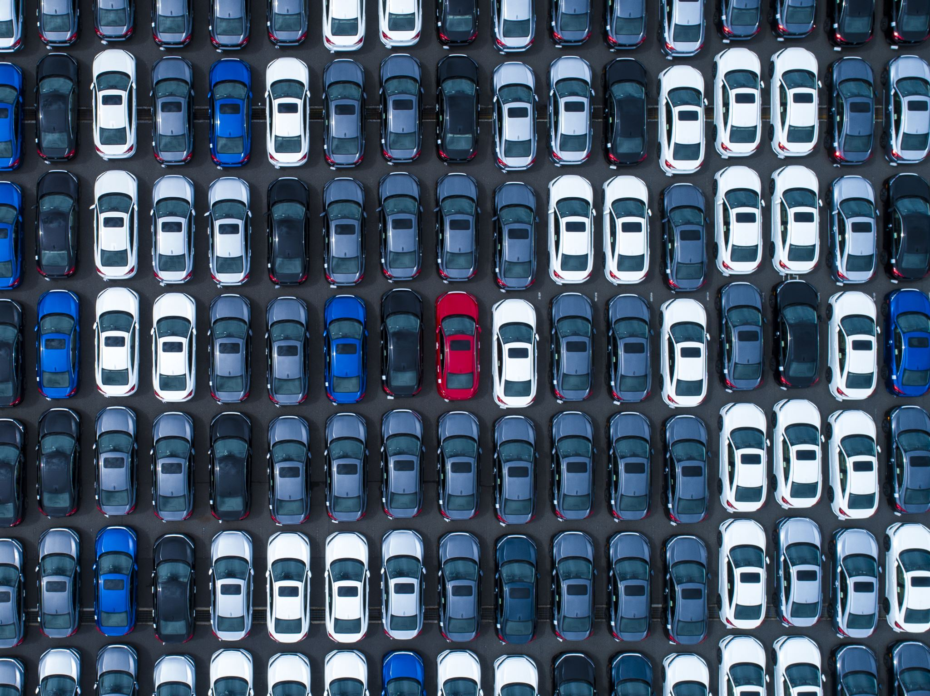
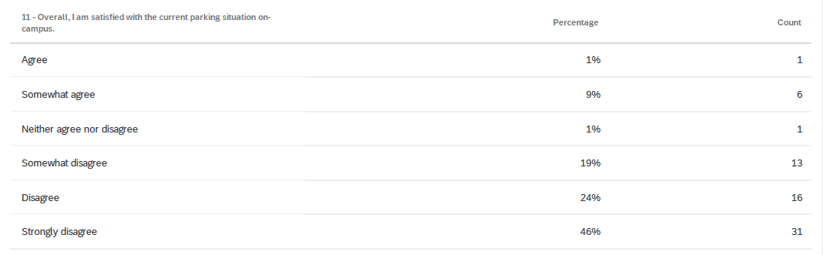
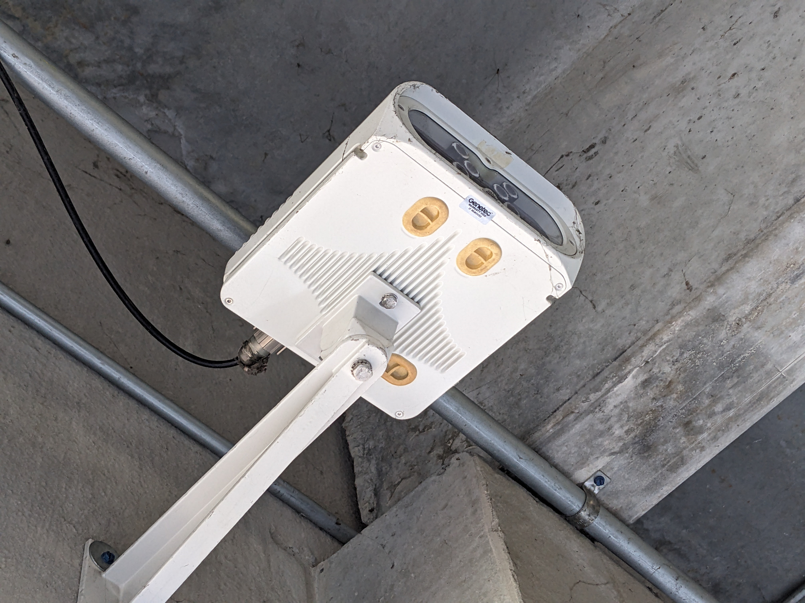
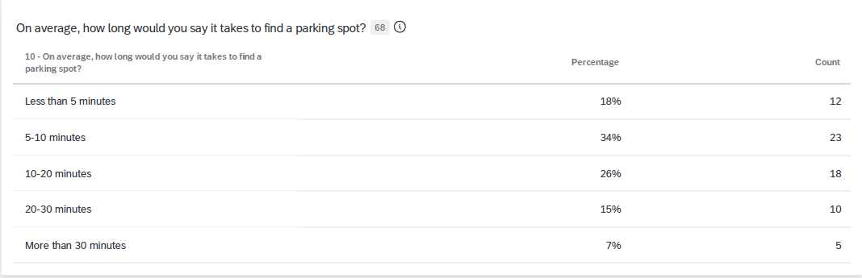
The Problem
Campus parking is a struggle.
A survey* of 68 UF undergraduates reveals:
89% of respondents were not satisfied with campus parking
48% of respondents took 10+ minutes to find parking on average
One cause: UF lacks easily available parking resources for those who must drive to campus
Parking difficulties cause drivers stress and frustration, wastes time, and creates traffic congestion.
* Primary data collected as part of an assignment in ENC3246
Notes:
“I’m sure many of you can relate to this, but campus parking is a struggle”
[CLICK]
“A survey of 68 UF undergrads reveals that 89% of respondents were not satisfied with parking on campus, and 48% of respondents took 10 or more minutes to find parking on average. If you extrapolate that to the overall campus population, that is a lot of people.”
[CLICK]
“One cause of this is that UF lacks easily available parking resources to help people find parking during busy periods for those who must drive to campus.”
[CLICK]
“Parking difficulties cause drivers stress and frustration, wastes time, and creates traffic congestion, which also puts both drivers’ and pedestrians’ safety at risk”
[CLICK]
Rubric: “CONTEXT: Problem Statement” – 6 points
“An explanation of what problem exists that creates the need for the project”

Slide 3
Our Solution — PAS
PAS = Parking Availability System
A low-cost, hardware/software system for parking information for facilities on campus
Components:
Edge camera devices
Vehicle and License Plate Recognition models
Database with lot and car information
Mobile app to view real-time parking information
Will provide drivers a resource to make informed parking decisions ahead of time with real-time data.
Notes:
“Our solution is PAS, the Parking Availability System . . . “
[CLICK]
“. . . [It is] a low-cost hardware/software system for providing drivers real-time, reliable, and accessible parking information for parking garages on campus.”
[CLICK]
“The components it will implement are:
Edge camera devices to monitor vehicle throughput
Vehicle and License Plate Recognition models on the device and in the cloud
Databases with lot and car information
and a Mobile App for users to easily view real-time parking information”
[CLICK]
“Our solution aims to alleviate the parking situation on campus by offering drivers a resource to make informed parking decisions with real-time parking data.”
[CLICK]
Rubric: “CONTEXT: Project Overview” – 6 points
“A description of the project, its goals, and how it solves the problem.”

Slide 4
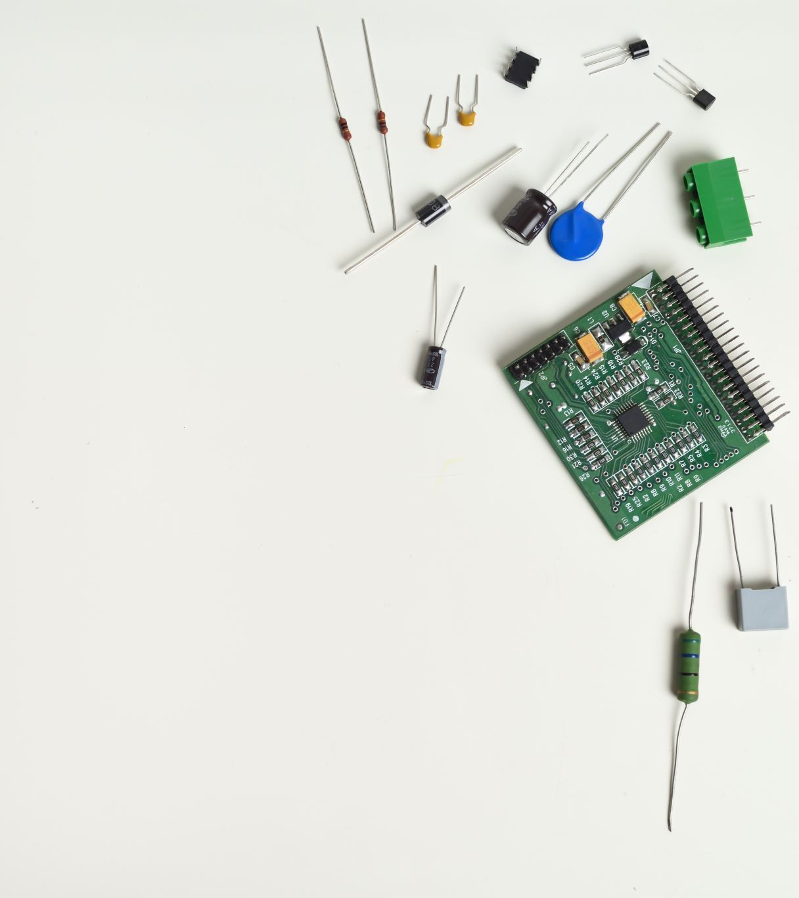
Tools we are using
Rasberry pi 3 b +
Camera
Battery
Motion sensor
Future upgrades
Rasberry pi 5
Camera 1080p

Slide 5
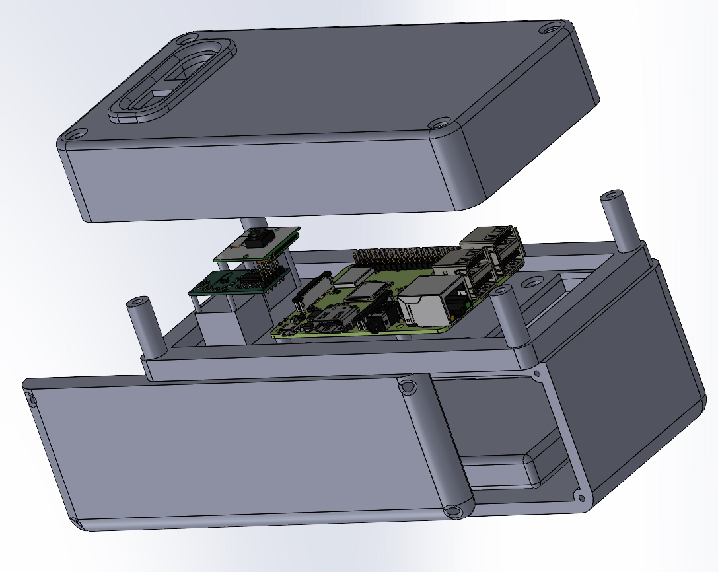
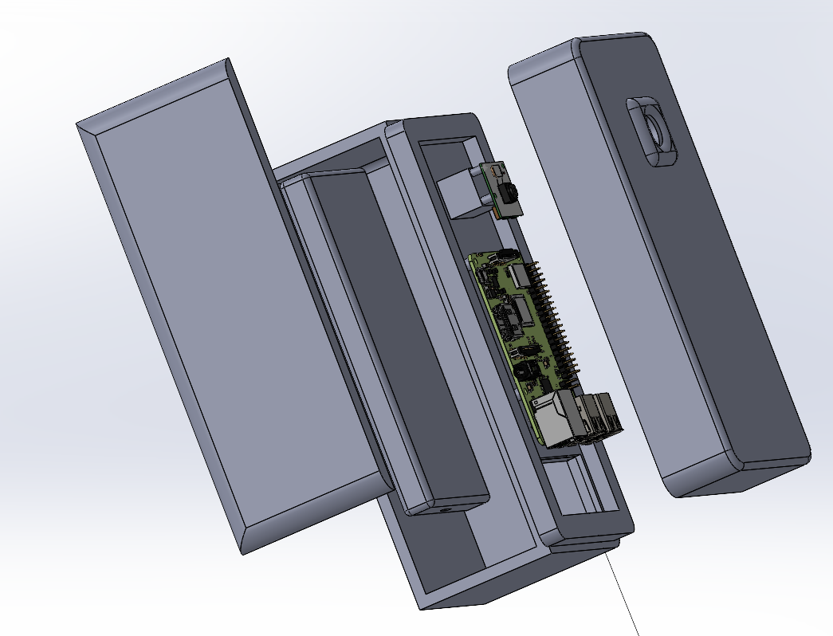
Physical Model and Hardware (Ryan)
The goal was to create a physical model that operates in real-world scenarios, simulating the actual environment to test functionality.
As well we wanted it to work in outdoor environments, with factors like:
Rain/Weather
Lighting/fog
And test Sensor range

Slide 6
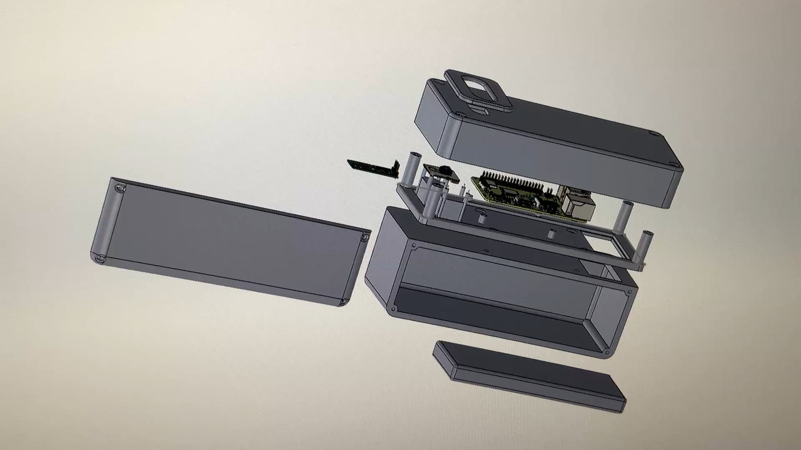

Slide 7
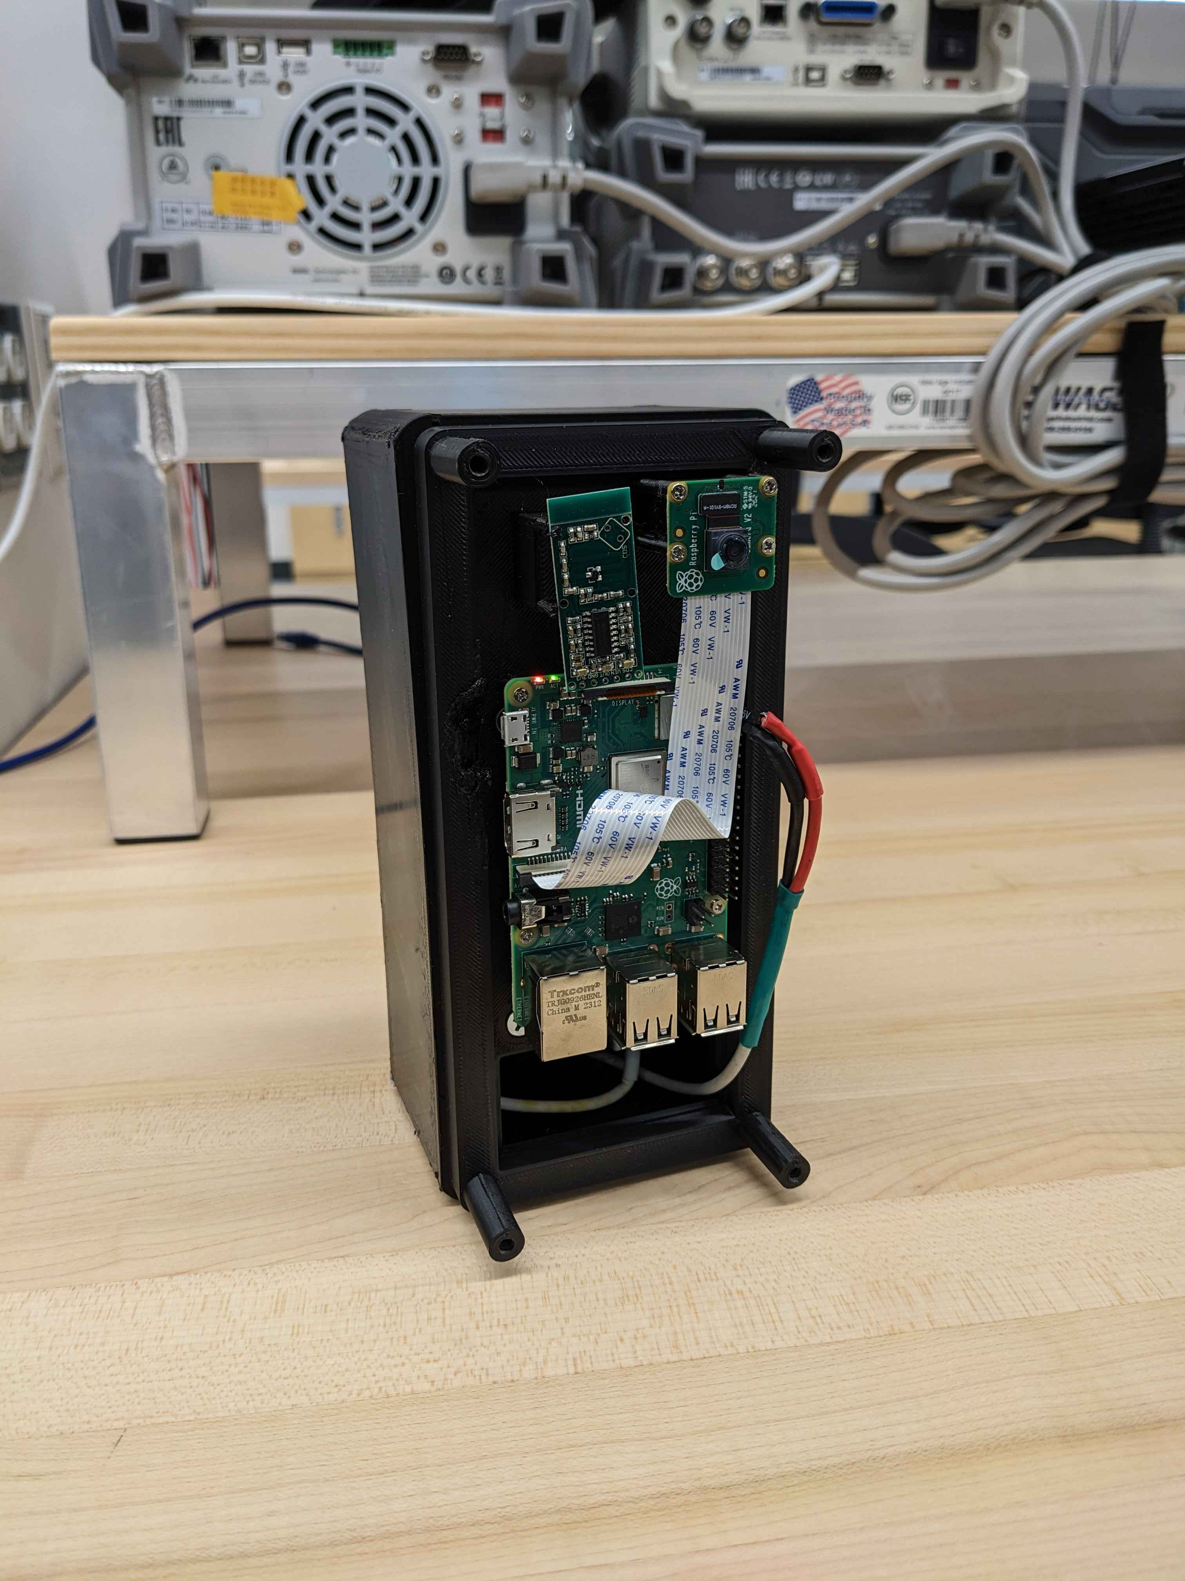
Raspberry Pi Model 3B+
Equipped with:
Module V2-8 Megapixel camera
Coliao RCWL microwave radar sensors
Purpose:
The raspberry pi (RPi) will serve as an on-premise technology that will run persistently
When an object is detected by the sensor, the camera module is spurred, and object detection is done on the captured frames
If a car is detected a database is updated to reflect the car leaving or entering the parking facility

Slide 8
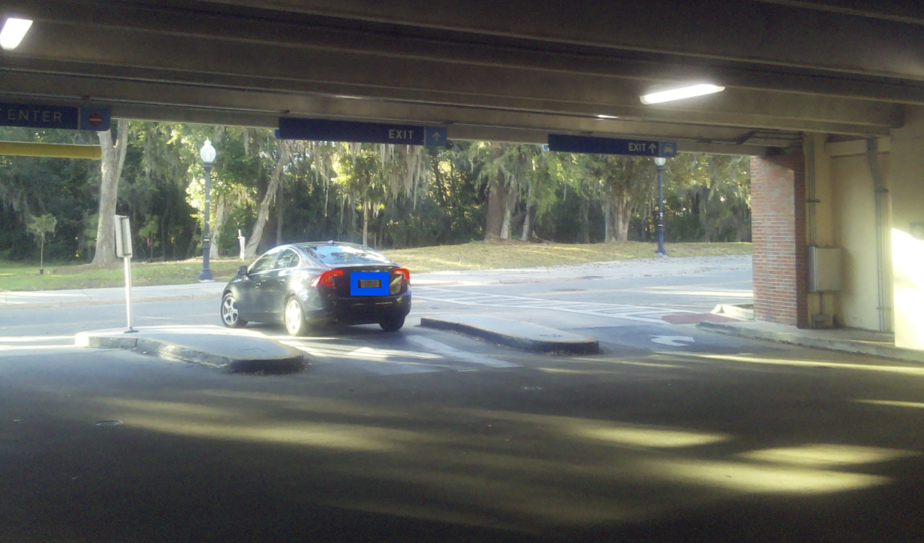
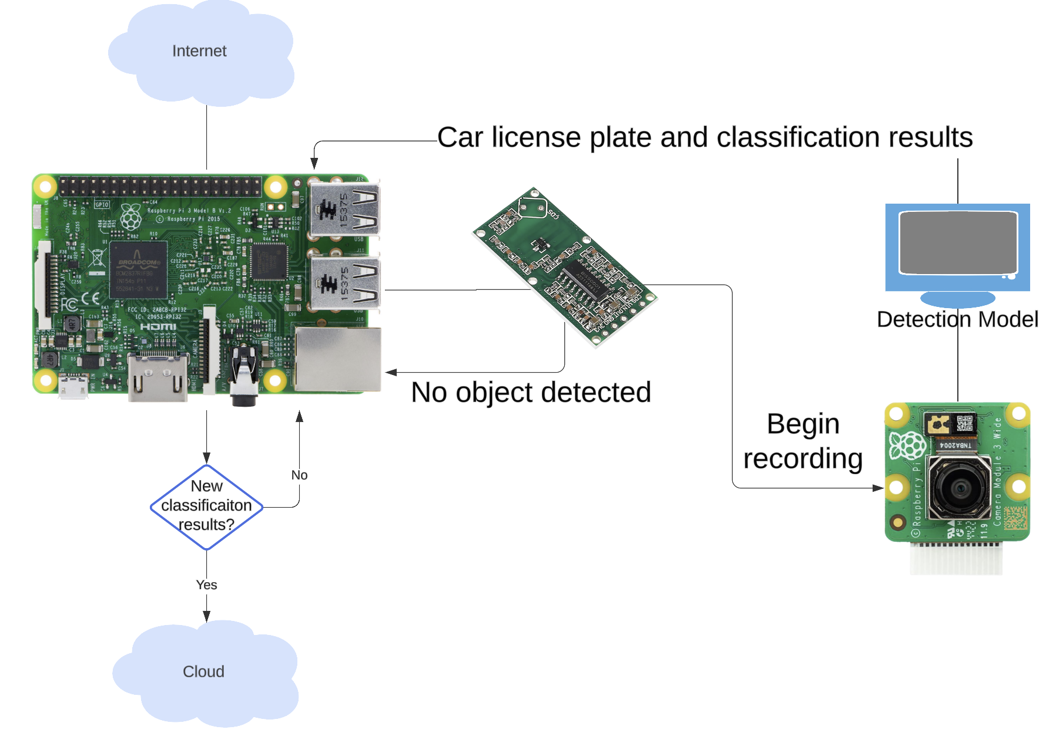
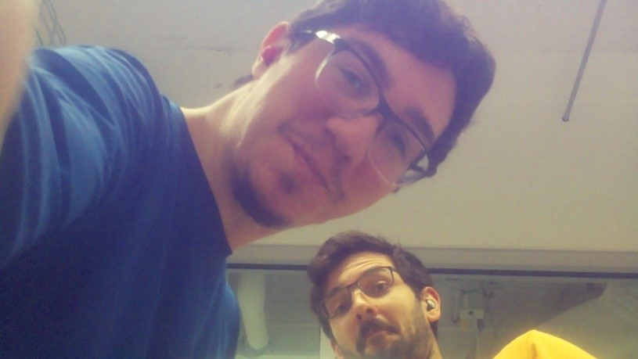
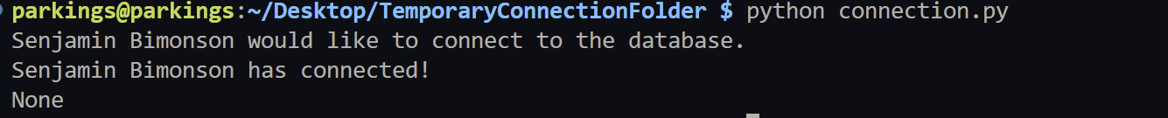

Slide 9
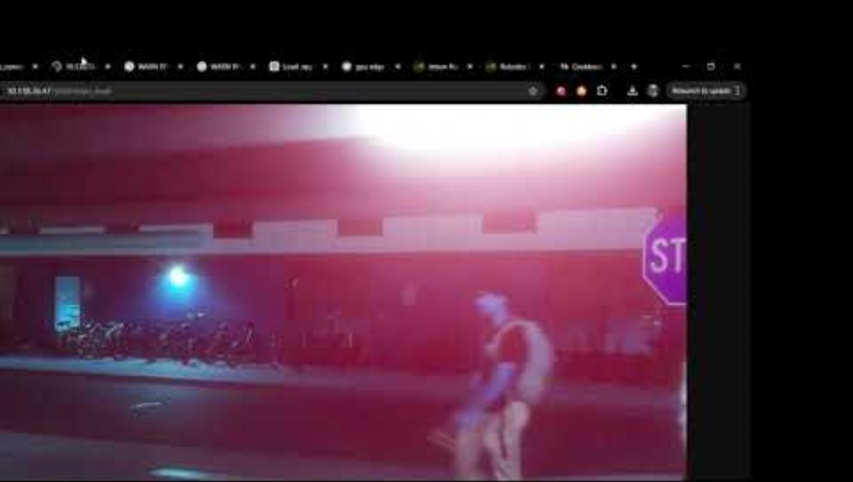
Raspberry Pi Garage Setup Demo
Notes:
https://youtu.be/NjIc-gpqBVY

Slide 10
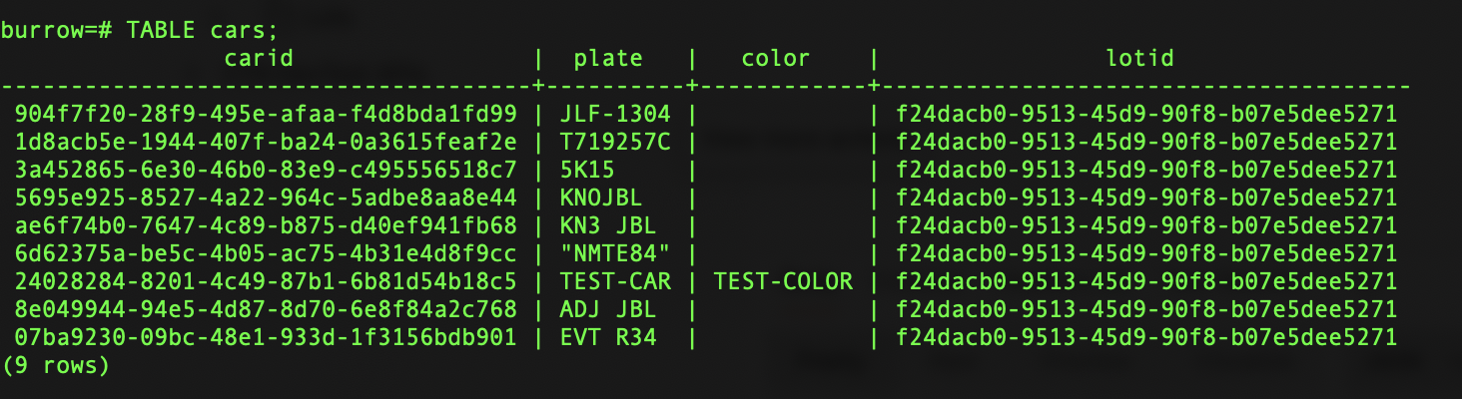
PostgreSQL Database
Relational database with 2 Tables:
CARS
LOTS
Database Versioning maintained by Pressly Inc. Goose
Migrations compiled in native Golang
Hosted on AWS Relational Database Service (RDS)

Slide 11
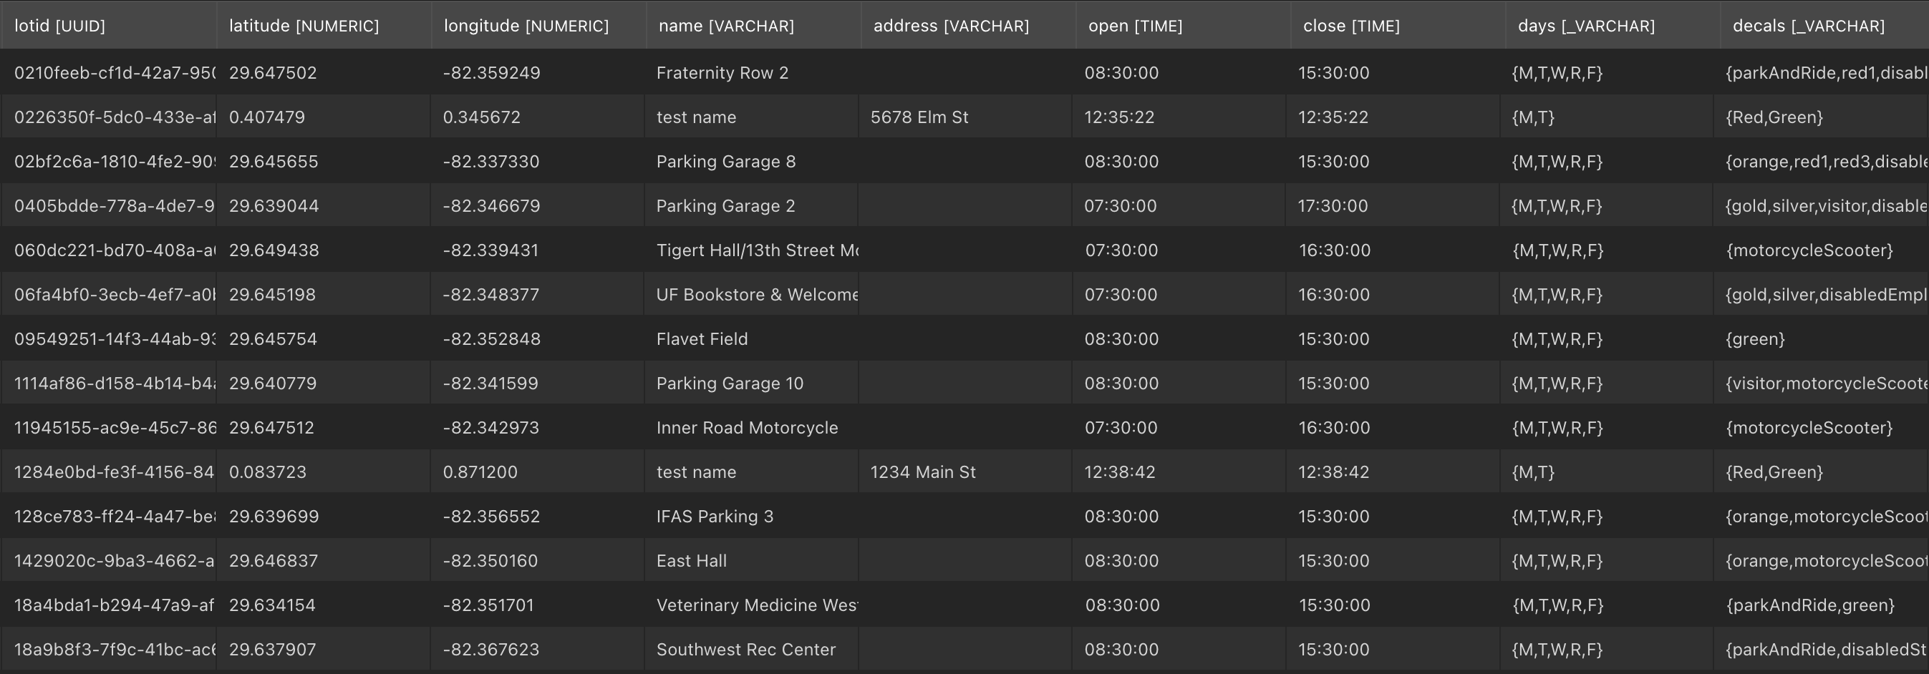

Slide 12
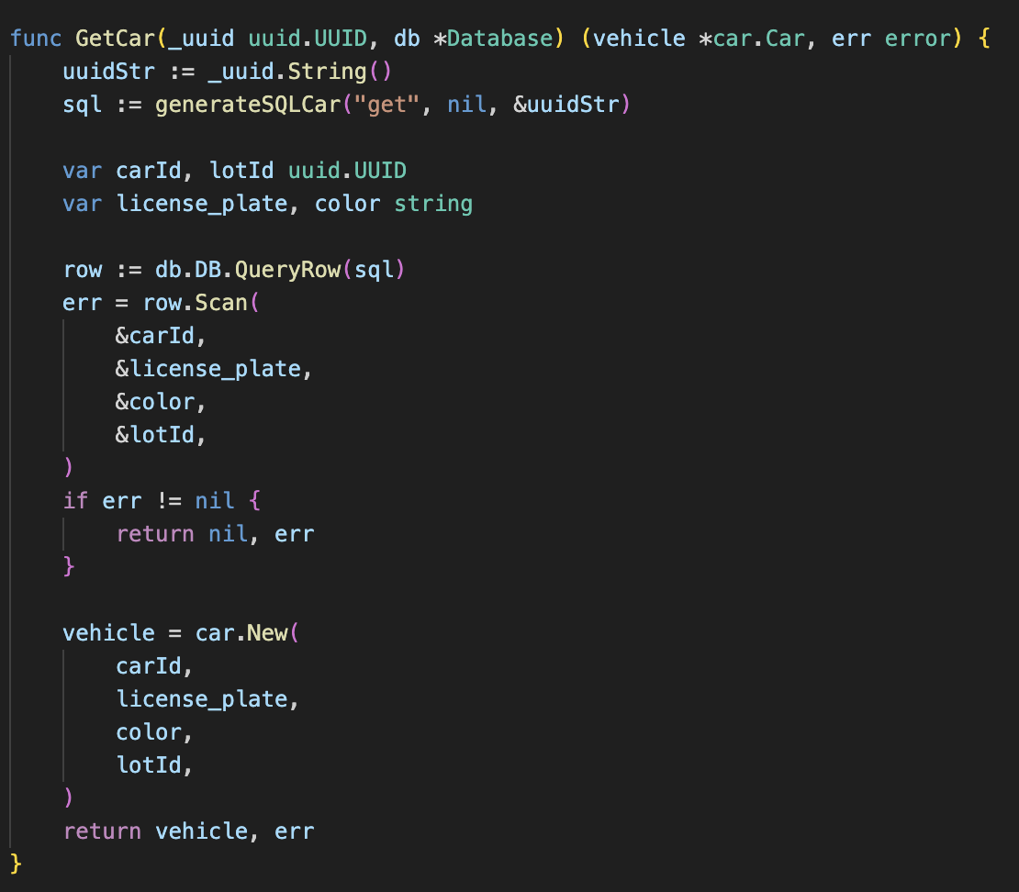
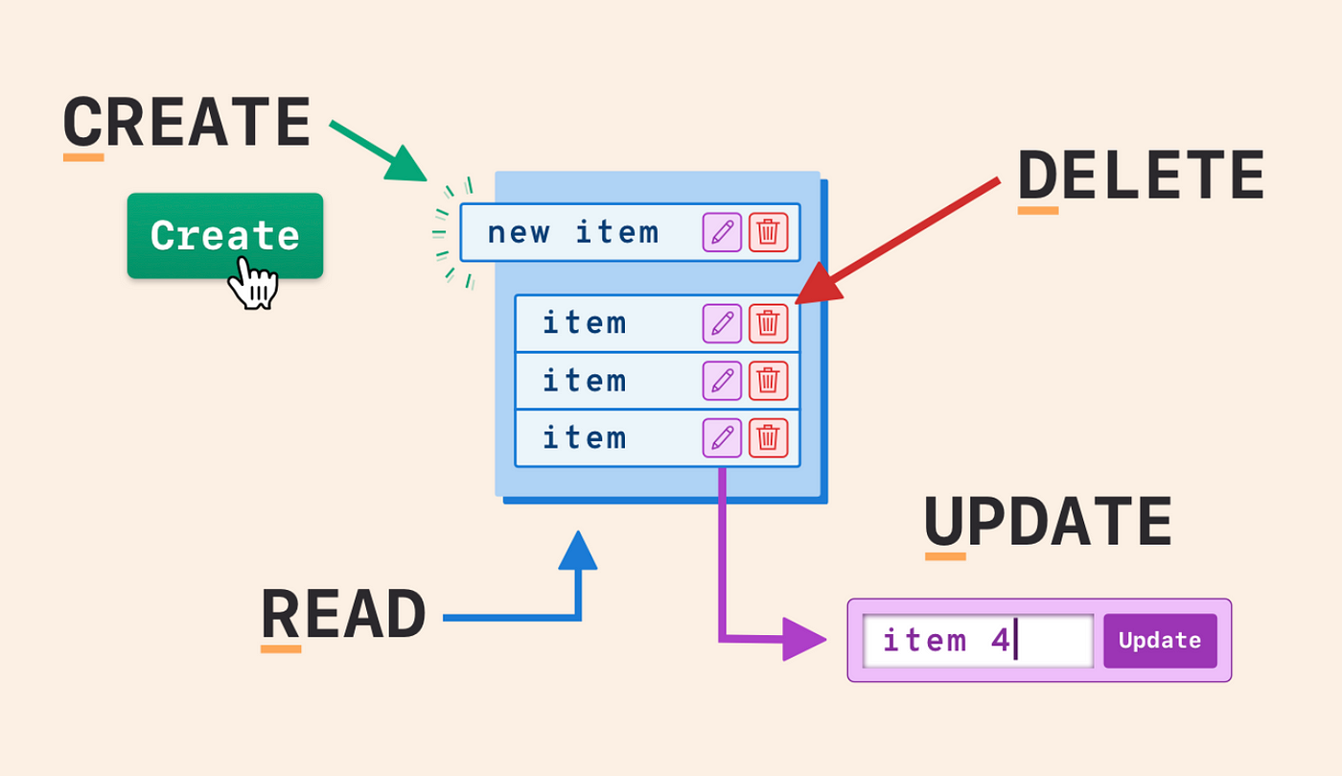
Backend API
Endpoints written in Golang
10 REST Endpoints interact with PostgreSQL database
CRUD operations on Cars:
Save car on enter
Retrieve car from database
Update car attributes (unused)
Delete car on exit
Get all cars in specific lot
CRUD operations on Lots:
Add lot
Get lot
Update lot information
Delete lot
Get all lots in database
Hosted on AWS EC2 instance

Slide 13
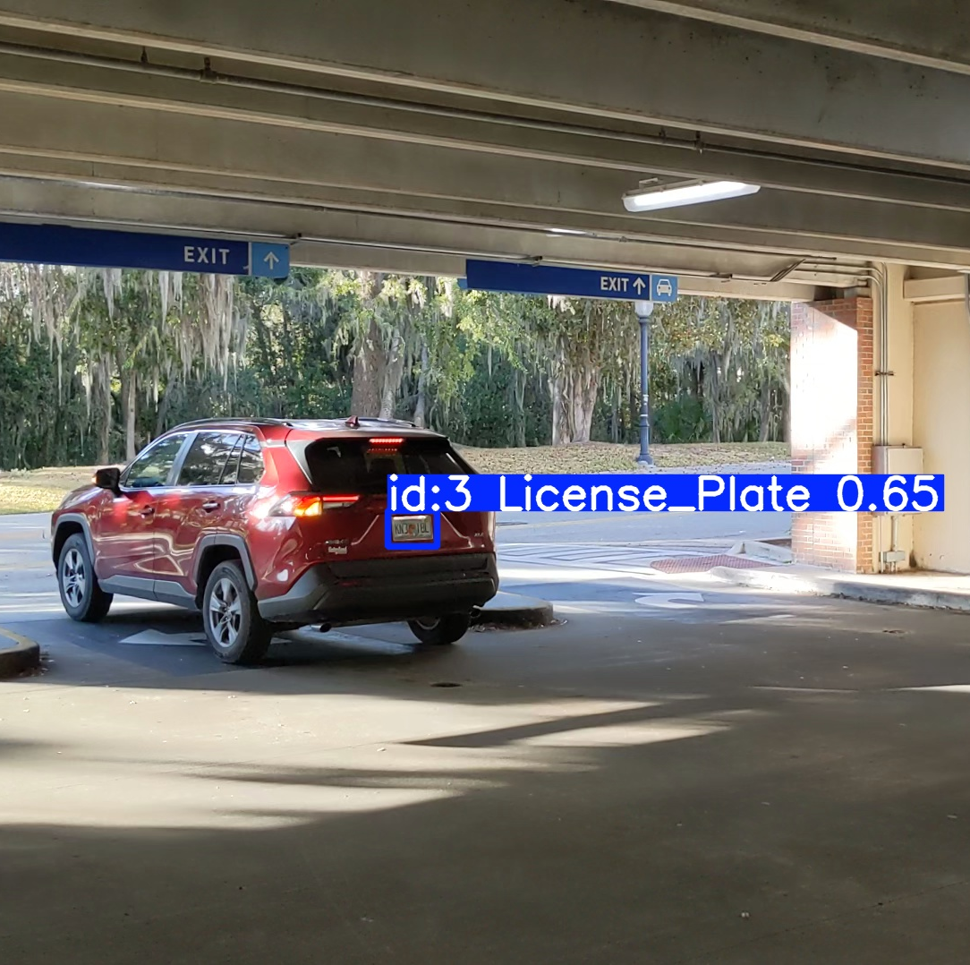
YOLOv11 License Plate Detection
YOLO11n model trained to detect license plates
Detection script written in Python3
Script spawns 2 threads:
Detecting and caching the license plate image frames locally
Sending the cached frames for further processing to OCR pipeline
Lightweight script written to run specifically on Raspberry Pi

Slide 14
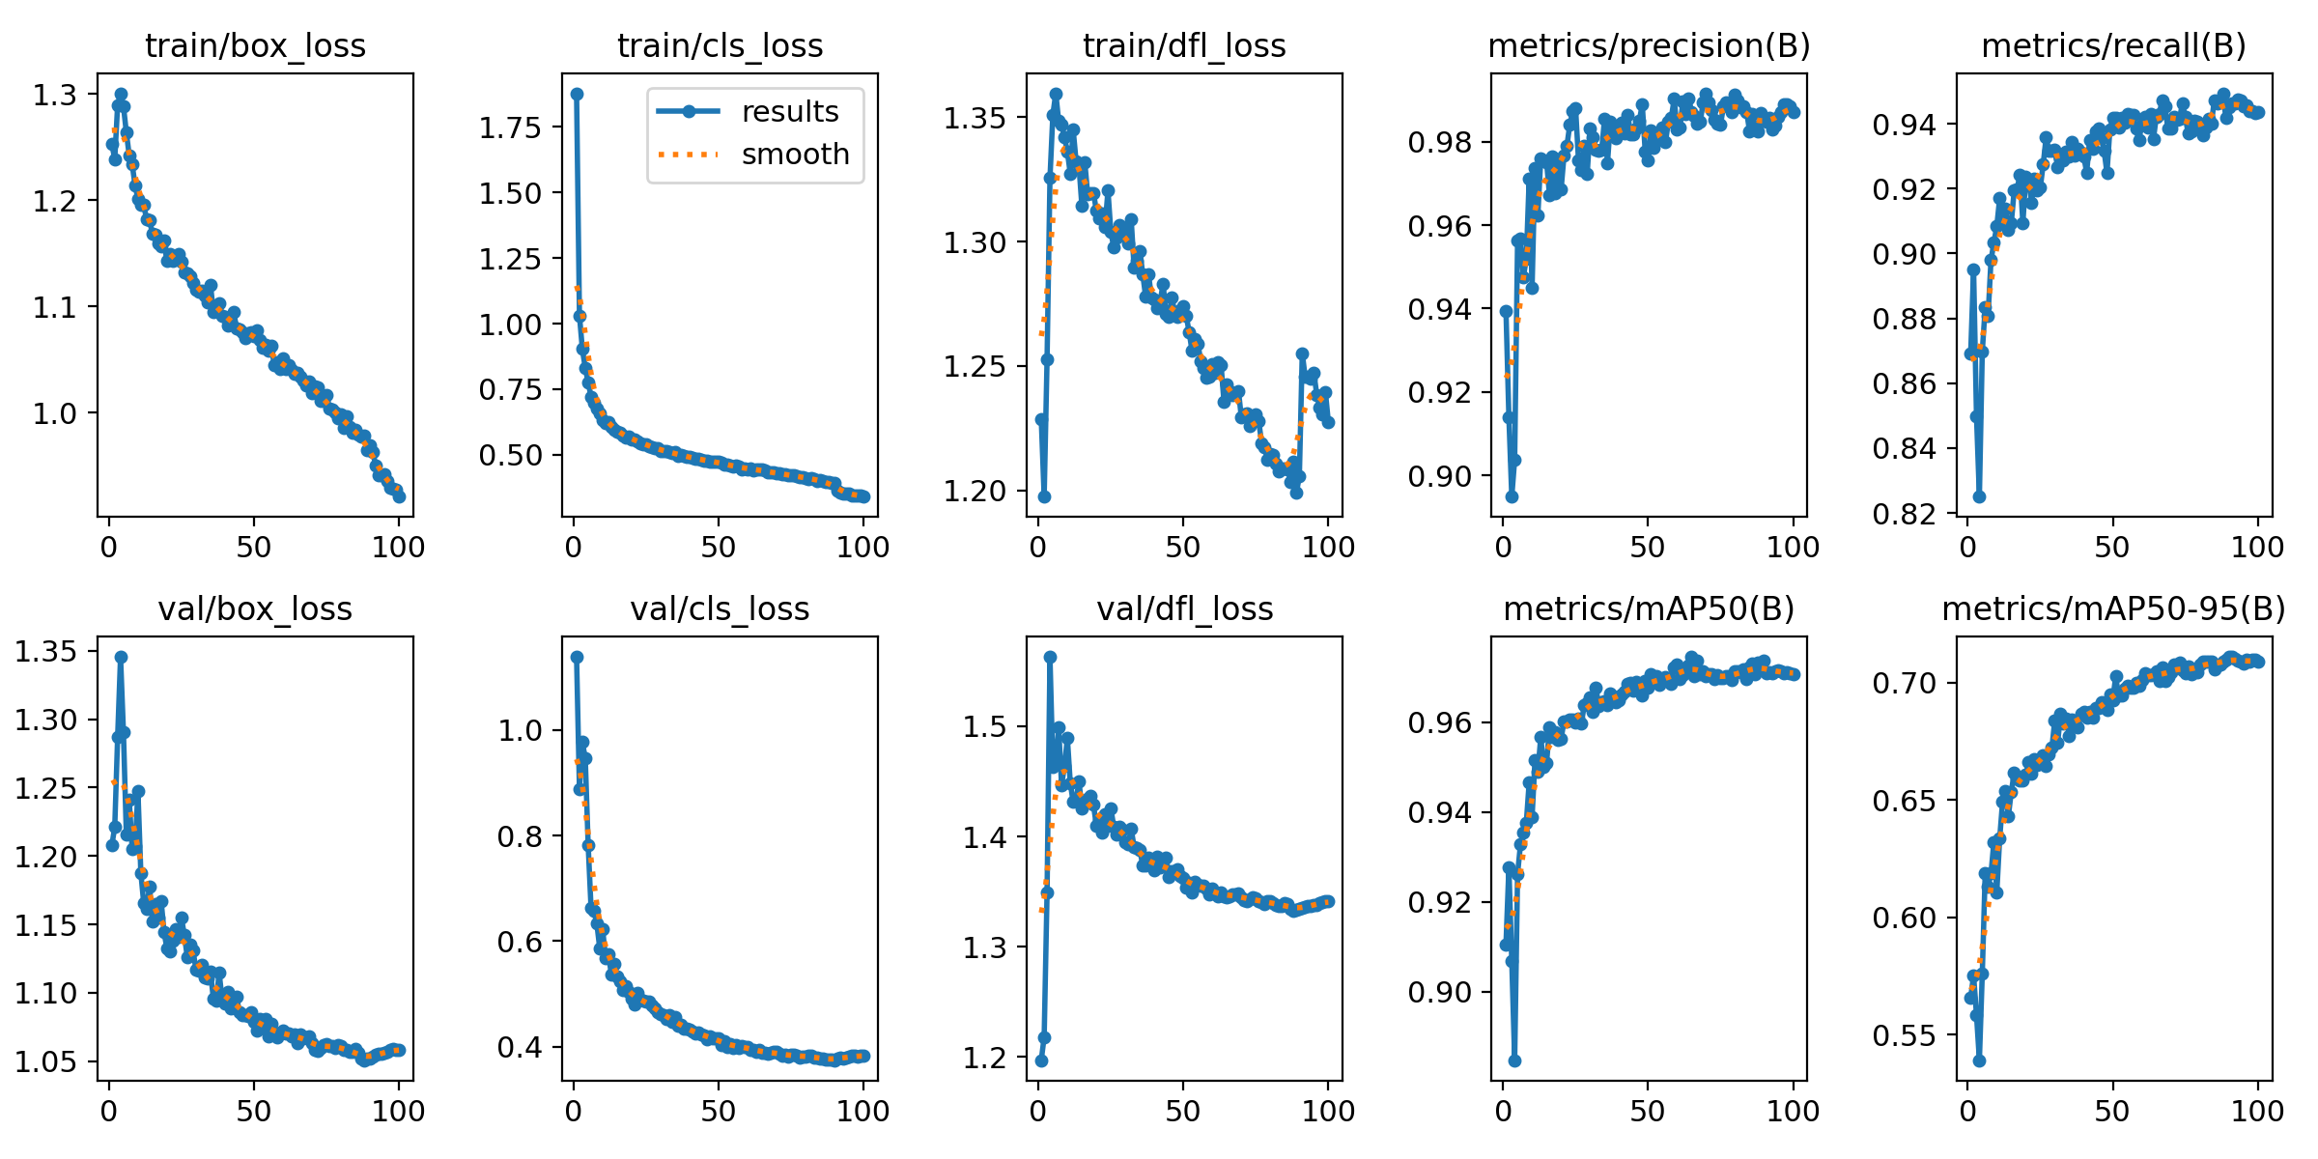

Slide 15
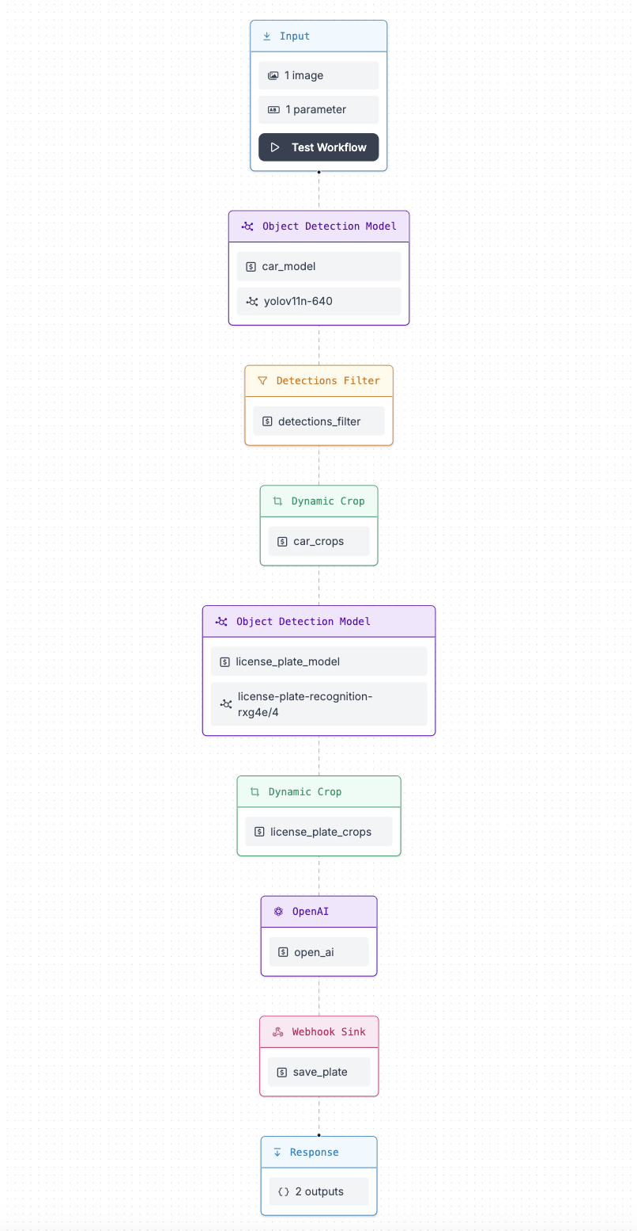
Roboflow OCR Pipeline
Multi-step Pipeline to verify detection and store to database
1. Verify Car exists in image frame
2. Verify License Plate exists in image frame
3. Run OpenAI's GPT-4 with Vision to read License plate
4. Call Save Car API endpoint to store the vehicle
5. Return Success/Failure & License plate text
Steps:

Slide 16
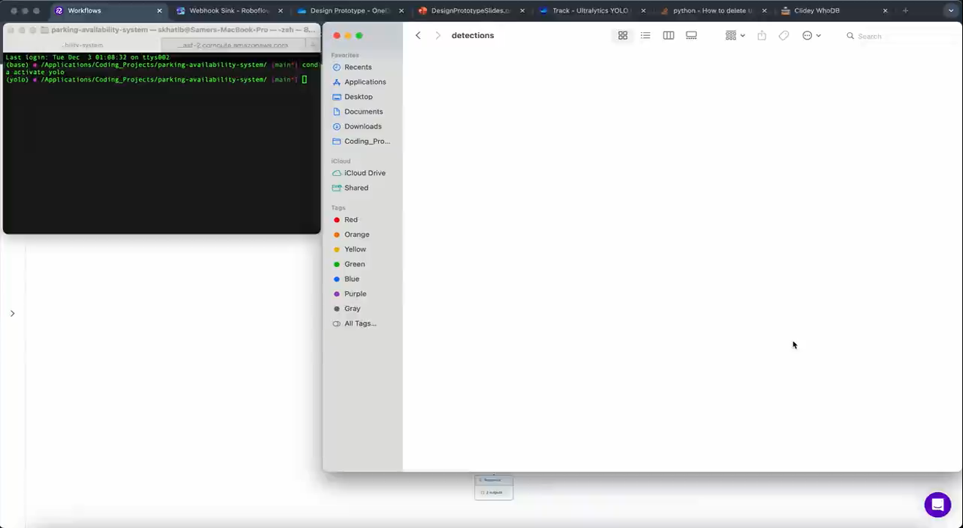

Slide 17

App Implementation for Real-Time Info
Built on top of the Dart/Flutter codebase for the “EZ Park UF” app by UF alum Drew Gill
The app receives lot information from the LOT table in PostgreSQL database
Users can get real-time information as the table gets updated by the car detection system
Notes:
“Given we’re working on a system with many components, it wasn’t feasible to build an app completely from scratch. So I reached out to the creator of the UF EZ Park app from a couple years ago, Drew, and he gave me permission to implement my feature from within his codebase.”
“The feature we implemented is a display of the real-time information, and this is done by having the app receives its lot information from the LOT table in the PostgreSQL database. Because of this users can get real-time information as the table gets updated by the car detection system.”
App (Erik)
Completed work
In-Progress Work
Planned work

Slide 18
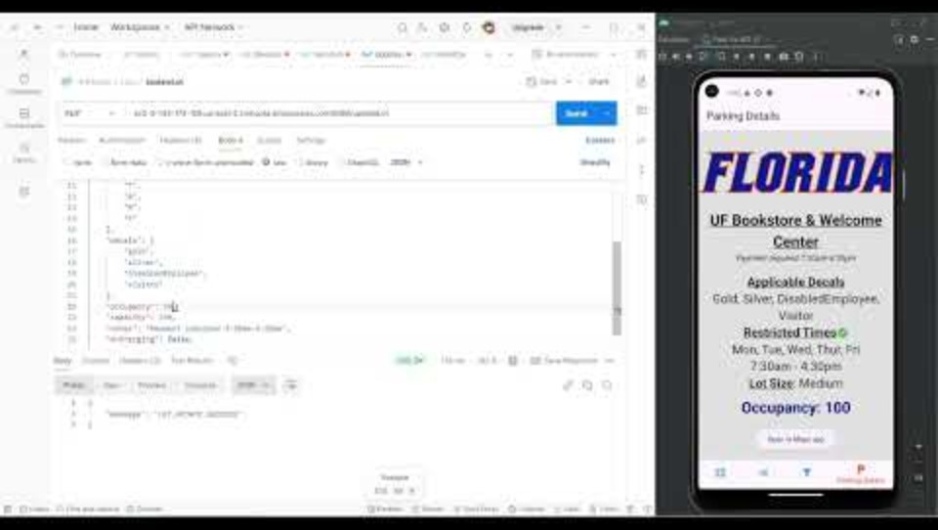
Notes:
YouTube Link:
https://youtu.be/slsWPT2LGRM

Slide 19
Next Steps
Task | Target Date | Milestone
(TD) Live testing and benchmarking | 01/31/25 | Alpha Build
Hardware Design Space Exploration
Implement YOLOv11 functionality on board
Achieve rudimentary persistent state of device functionality | 02/21/25 | Beta Build
Revamp image frame caching mechanism
Clean up redundancies in OCR Pipeline | 03/21/25 | Release Candidate
Make use of Update Car endpoint
Add detection and storage of car attributes (color, number of wheels, etc.) | 04/11/25 | Production Release
Notes:
Sprint Technical Debt:
System to store frames on connection loss
Testing performances
Live testing of the system
Hardware design-space exploration

Slide 20
Questions?
Notes:
Todo todo

